Slide 1
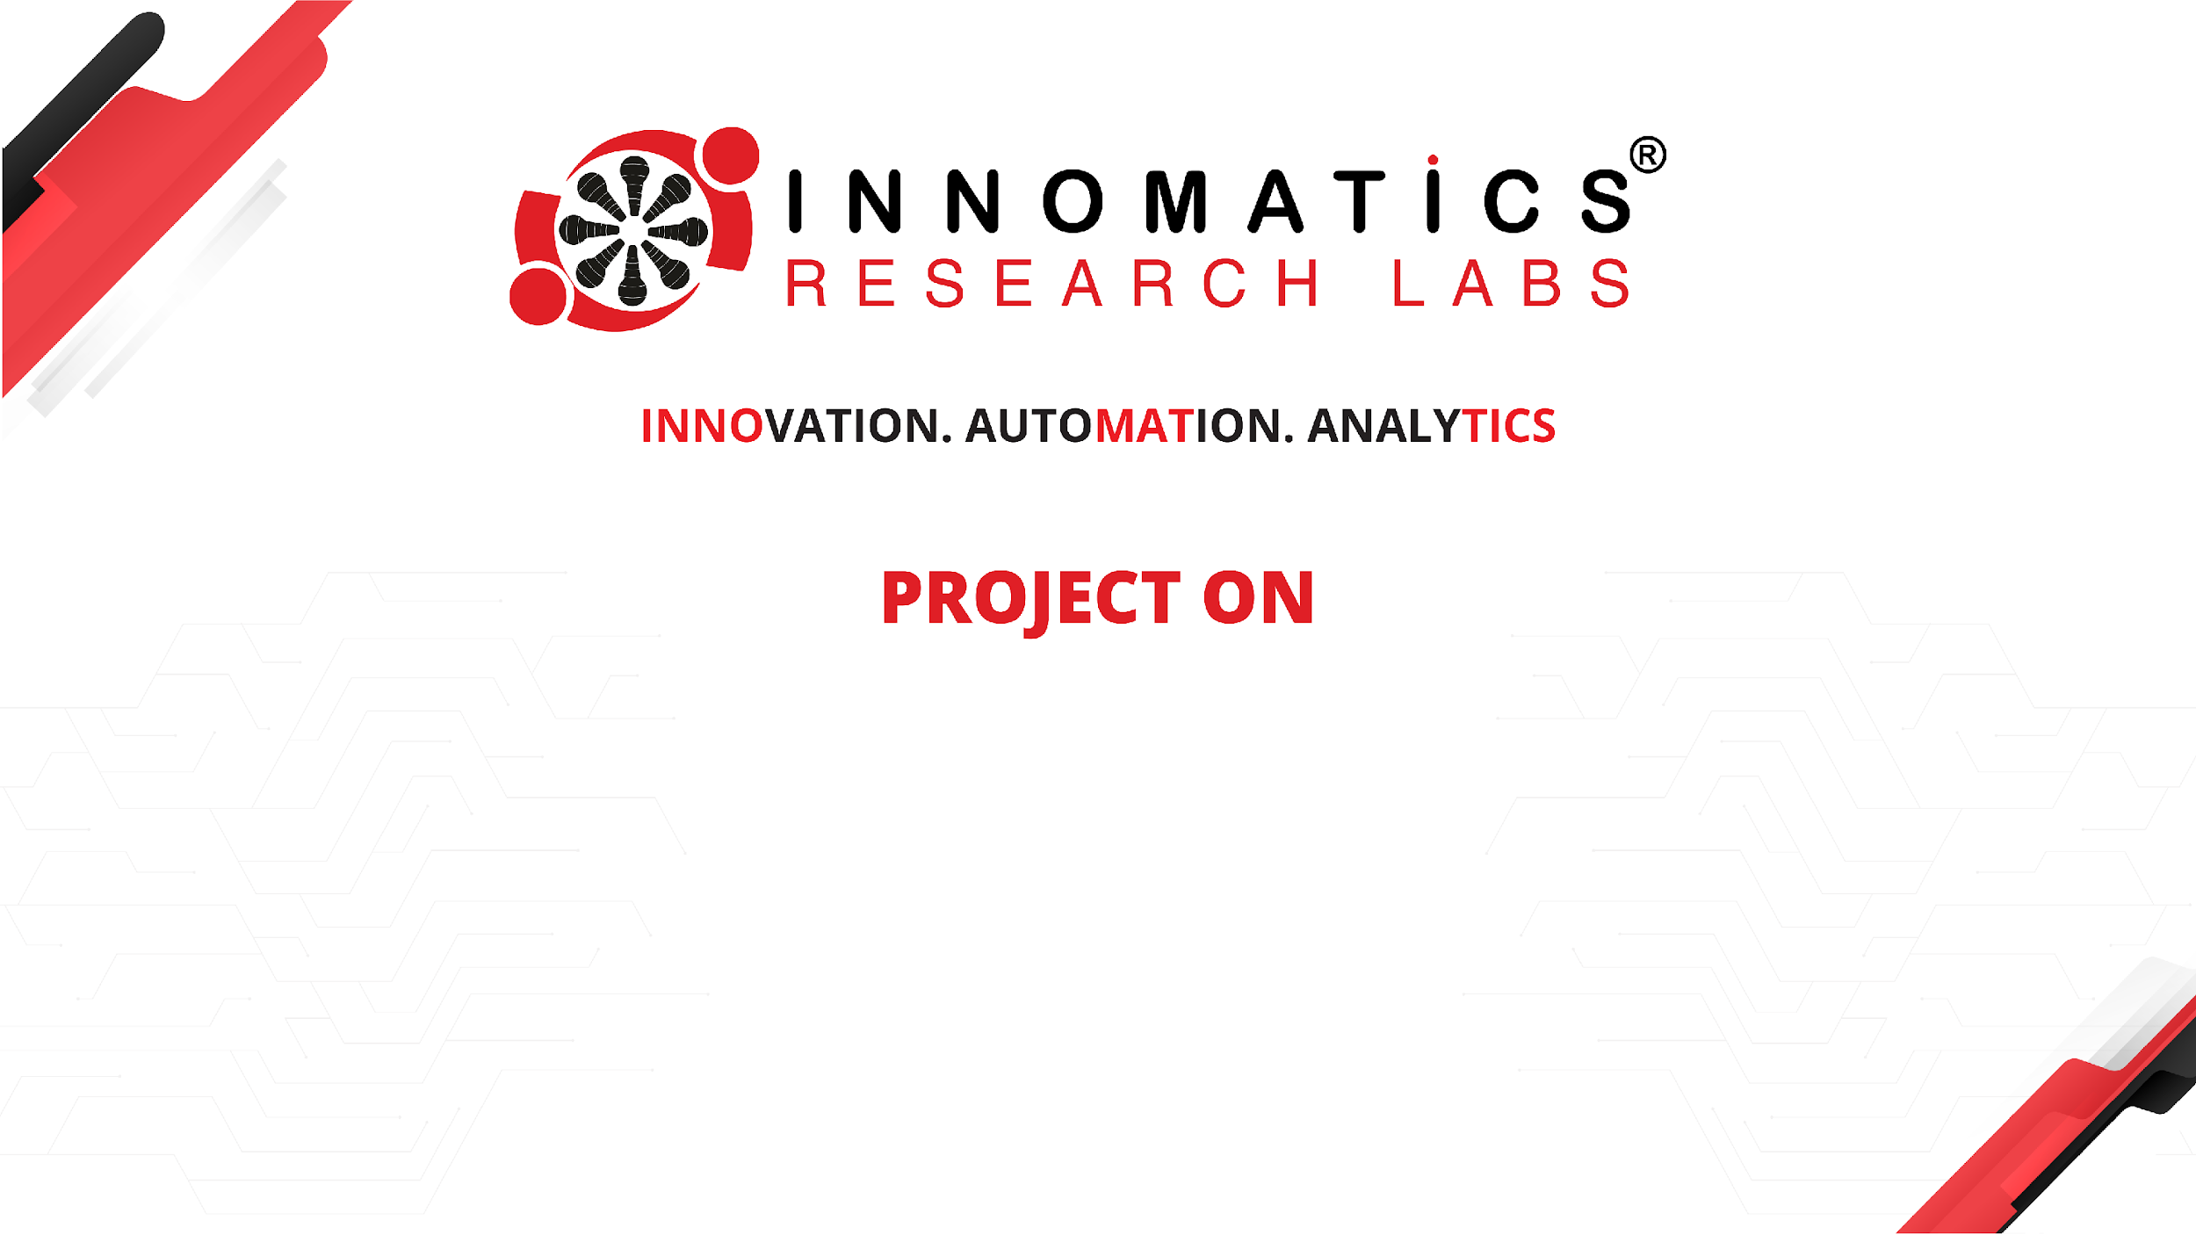
AI Virtual Mouse
Emmadi Srikar
Batch No :436
Innomatics Research
Labs Dilshuknagar

Slide 2
About me
I am Emmadi Srikar.
I completed my B.Tech in Computer Science and Engineering from St Mary’s Group of Institution Hyderabad.
LinkedIn : https://www.linkedin.com/in/emmadi-srikar-03baaa337
Github : https://github.com/srikar42

Slide 3
AGENDA :
Problem Statement
Objective
Technologies Used
System Architecture
Hand Tracking Module
Gesture Mapping
Features Implemented
Advantages
Limitations
Conclusion

Slide 4
Introduction :
This project is developed using the CRISP-ML methodology, starting from understanding the need for touch-free interaction to deploying a real-time AI Virtual Mouse system.
Real-time video data is processed to extract hand landmarks, which are used for gesture recognition.
The recognized gestures are mapped to mouse actions, ensuring a structured and reliable implementation.
This structured approach improves the system’s usability, performance, and real-time responsiveness in practical scenarios.

Slide 5
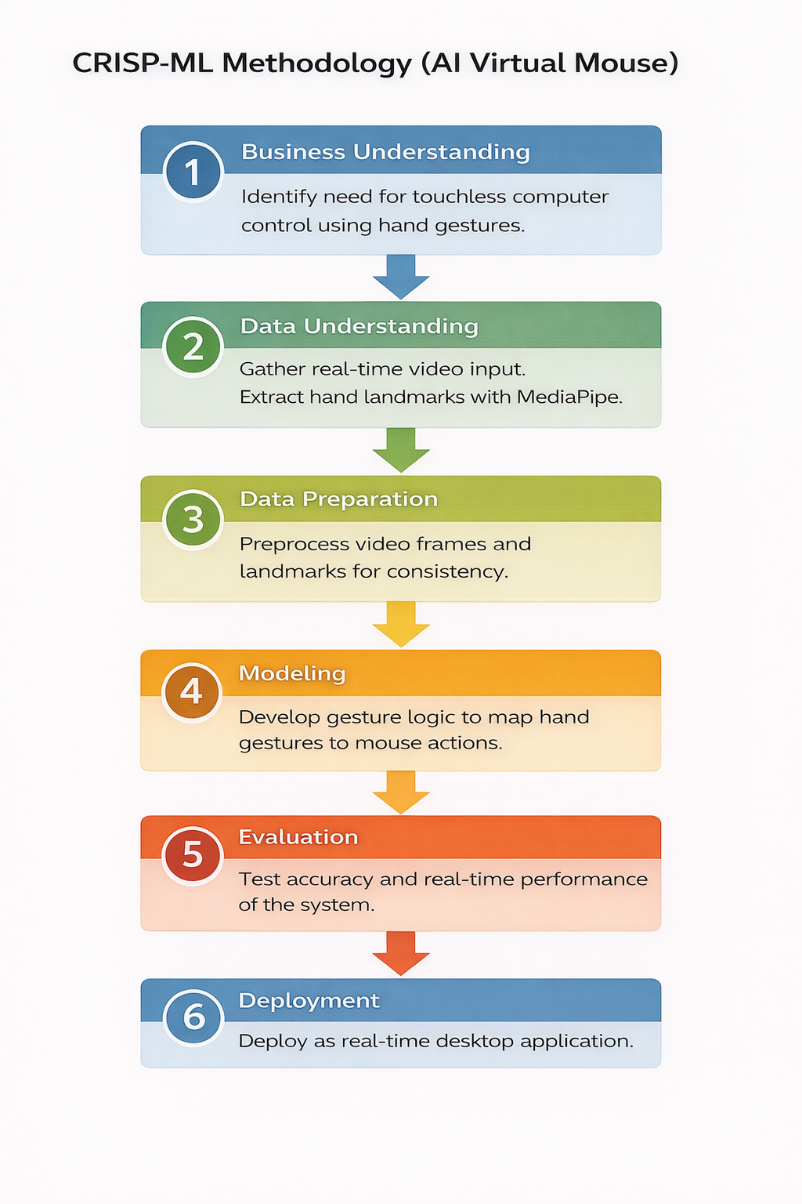

Slide 6
Problem Statement :
In many real-world situations—such as hospitals, public computer systems, classrooms, libraries, and workplaces—people frequently use shared computers. Traditional physical mice and touch devices require direct hand contact, which can spread germs, cause hygiene issues, and inconvenience users who have mobility limitations or physical disabilities.
Therefore, there is a need for a touch-free, gesture-based virtual mouse system that allows users to control the computer using only their hand movements captured by a webcam The goal is to create an AI-powered virtual mouse that recognizes moving the cursor, clicking, scrolling without touching any physical device.

Slide 7
Objective :
This project solves the problem by using:
A webcam to capture hand movements
AI-based hand landmark detection
Gesture recognition logic to perform mouse actions
Users can operate the computer only using hand gestures, without touching any hardware

Slide 8
Technologies Used :
Python – Programming language
OpenCV – Camera handling & UI
MediaPipe – AI-based hand tracking
NumPy – Mathematical mapping
AutoPy – Mouse movement & click
PyAutoGUI – Scrolling & screenshot

Slide 9
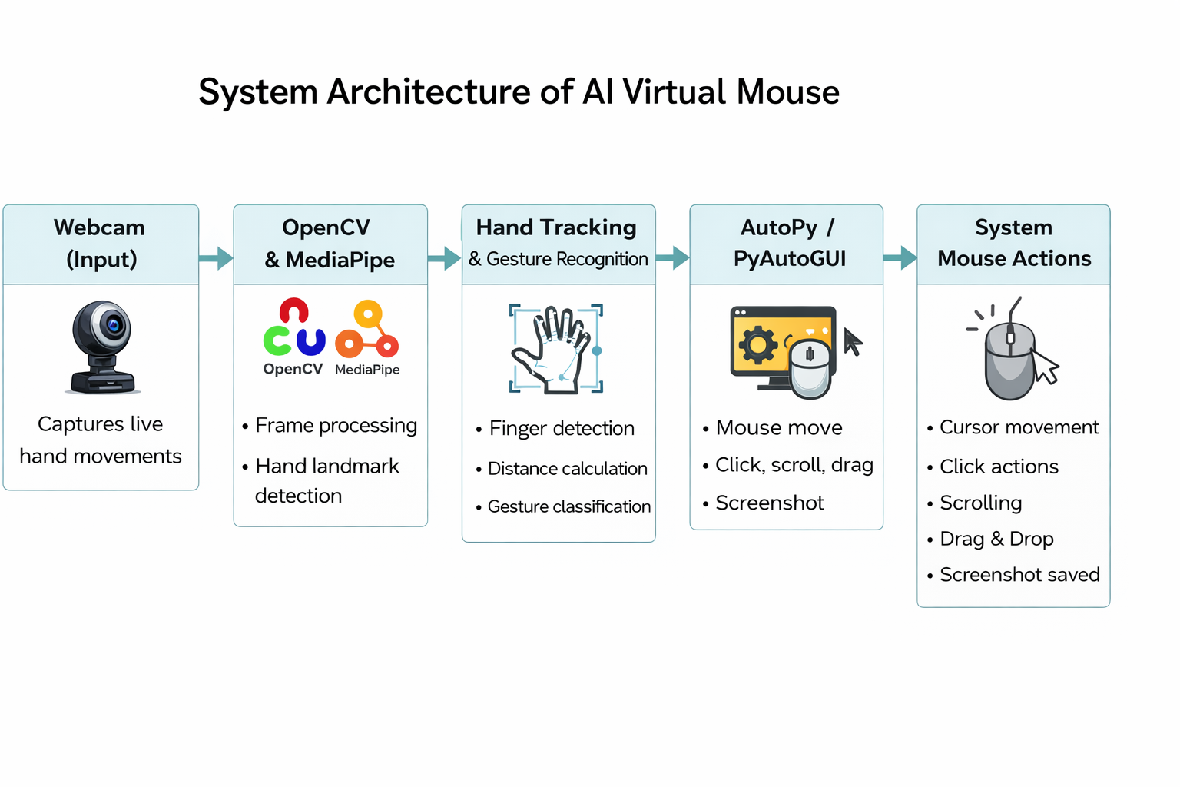

Slide 10
Hand Tracking Module :
Detects 21 hand landmarks
Tracks finger positions
Identifies which fingers are up
Calculates distance between fingers
Used for gesture recognition

Slide 11
Gesture Mapping :
👍 Thumb | ☝️ Index | ✌️ Middle | 🤟 Ring | 🤘 Pinky
Action | Gesture (With Emojis) | How to Do It
Move Mouse | ☝️ (Index up only) | Keep only index finger up and move your hand
Left Click | ☝️ + ✌️ (together) | Bring index & middle close
Right Click | 👍 + ☝️ (pinch) | Pinch thumb & index
Double Click | ☝️ + ✌️ + 🤟 (3 fingers up) | Raise index, middle, ring
Scroll Up | ☝️ + ✌️ + 🤘 | Raise index, middle, pinky
Scroll Down | ☝️ + 🤘 | Raise index & pinky
Drag & Drop | 👍 + ☝️ (pinch & hold) | Pinch and hold, move hand
Screenshot | 👍 + ✌️ (pinch) | Pinch thumb & middle
Exit App | Press Q | Press Q on keyboard

Slide 12
Demo Video :
https://www.linkedin.com/posts/emmadi-srikar-03baaa337_ai-computervision-pythonprojects-activity-7412896323714265088-nmYB?utm_source=share&utm_medium=member_desktop&rcm=ACoAAFSzla8Be3v9gFye535Y_jQ9rT0fL5q4Q6A

Slide 13
Features Implemented :
Real-time hand tracking
Touchless mouse movement
Left click, right click, double click
Scroll up & down
Drag and drop
Screenshot capture
FPS display
Action feedback on screen

Slide 14
Advantages :
Contactless interaction
Useful for hygiene environments
Accessibility support
No external hardware required
Cost-effective solution

Slide 15
Limitations :
Depends on lighting conditions
Background noise may affect detection
Needs good camera quality
Slight delay in low-end systems

Slide 16
Challenges Faced :
Works poorly in low lighting
Cursor sometimes shakes
Similar gestures can get confused
Performance drops on slow systems

Slide 17
Conclusion :
Successfully built an AI Virtual Mouse using computer vision.
Demonstrates practical application of hand tracking & gesture recognition.
Project shows real-time AI interaction with system hardware.
Can be extended for smart systems and accessibility tools.

Slide 18

THANK YOU

